Slide 1
Multiple Access

Slide 2

Data link layer divided into
two functionality-oriented sublayers
Upper sublayer is responsible for Flow and Error Control (Logical Link Control)
Lower sublayer is responsible for resolving access to the shared medium (Medium Access Control)

Slide 3

Taxonomy of multiple-access protocols
Two or more nodes are connected to a common (called a multipoint or broadcast) link, Medium Access Control protocol is used to coordinate the access to the link
Many formal protocols were developed to handle access to a shared link

Slide 4
RANDOM ACCESS
In random access or contention methods, no station is superior to another station and none is assigned the control over another.
No station permits / does not permit, another station to send.
Each station follows a predefined procedure, including testing of the medium, whenever it has data to send.
The decision depends on the state of the medium (idle or busy).

Slide 5
Random Access
No scheduled time for a station to transmit
Transmission is random among the stations(Random Access)
No rules specify which station should send next.
Stations compete with one another to access the medium(Contention Methods)

Slide 6
If more than one station tries to send, there is an access conflict called collision
  Frames will be either destroyed or modified
To avoid the access conflict, the following questions need to be answered
  When can the station access the medium
  What can the station do if the medium is busy
  How can the station determine the success or failure of the transmission
  What can the station do if there is an access conflict

Slide 7
ALOHA
ALOHA was developed at University of Hawaii, in 1970’s
Developed for wireless LAN but can be used for any shared medium
Called pure ALOHA
Idea:
  Station can transmit the frame whenever it has frame to send

Slide 8

Frames in a pure ALOHA network

Slide 9
Pure ALOHA protocol expects acknowledgements from the receiver
If Timer expires, sender needs to resend the frame
Stations resend the frame after timeout then again collision will occur
  So each station needs to wait for another random time period.
Maximum No. of retransmission attempts is K_{max}.
Timeout period is equal to maximum possible round trip delay ( 2 * transmission delay)
Back off Time :- Random Wait time is R (b/w 0 and 2^{k} – 1) * Max Propagation time or Average time required to send a frame.

Slide 10

Procedure for pure ALOHA protocol

Slide 11

Vulnerable time for pure ALOHA protocol
Vulnerable time, Time period having the possibility of collision (2*T_{fr})
Fixed length frames, each taking T_{fr} to send

Slide 12
The throughput for pure ALOHA is
S = G × e ^{−2G} .
Where G is the average number of frames transmitted,
S is the average No. of successful transmissions.
Euler's number is ‘e’ is 2.71828
The maximum throughput
S_{max} = 0.184 when G= (1/2).

Slide 13
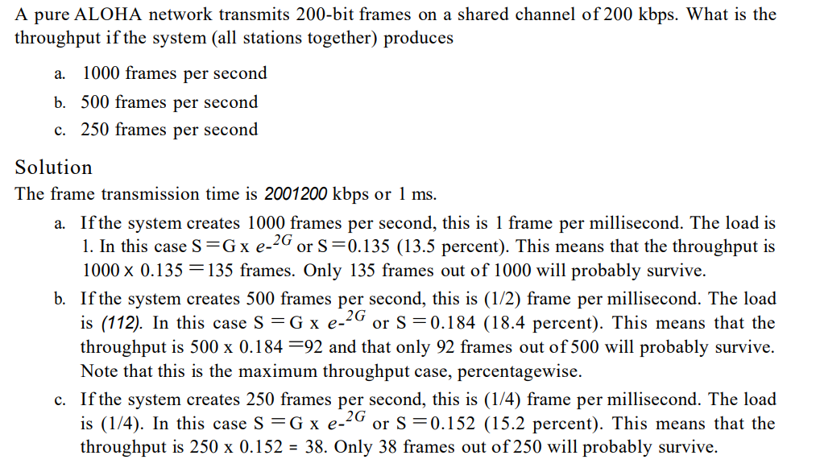

Slide 14
Slotted ALOHA
Vulnerable time of pure ALOHA= 2 * T_{fr}
No rule to decide when the station should send the data
Slotted ALOHA to improve the efficiency
Forces the station to send the frame at the beginning of the time slot
Station misses it chance should wait for the next time slot.

Slide 15

Frames in a slotted ALOHA network

Slide 16

Vulnerable time for slotted ALOHA protocol

Slide 17
Vulnerable time = T_{fr}
The throughput for slotted ALOHA is
S = G × e^{−G} .
The maximum throughput
S_{max} = 0.368 when G = 1.

Slide 18
Carrier Sense Multiple Access (CSMA)
CSMA was developed
  To minimize the chance of collision
  To increase the efficiency
CSMA requires the station to first listen to the medium then transmit
Collision can be reduced but can’t be eliminated

Slide 19

Vulnerable time in CSMA
The Vulnerable time for CSMA is Propagation time

Slide 20
Persistence Methods
What a station should do
  If the channel is busy?
  If the channel is idle?
Persistence strategy defines the procedures for a station that senses a busy medium

Slide 21

Behavior of three persistence methods

Slide 22
1-Persistent CSMA
In this method, station that wants to transmit data continuously sense the Channel to check whether the channel is idle or busy.
If the channel is busy , the station waits until it becomes idle.
When the station detects an idle channel, it immediately transmits the frame with probability 1. Hence it is called 1-persistent CSMA.
highest chance of collision
When the collision occurs, the stations wait a random amount of time and start all over again.

Slide 23
Non –persistent CSMA
  A station that has a frame to send senses the channel.
  If the channel is idle, it sends immediately.
  If the channel is busy, it waits a random amount of time and then senses the channel again.
  In non-persistent CSMA the station does not continuously sense the channel for purpose of capturing it when it defects the end of precious transmission
  Reduces the chance of collision
  Reduces the efficiency of the N/w because medium remains idle, when the data is ready to transmit

Slide 24
p-Persistent CSMA
Used, if the channel has time slots with a duration equal or greater than the maximum propagation time
Combines the advantages of other two strategies
Reduces chance of collision and improves efficiency
  With probability p, sends a frame
  With prob, q=1-p it checks for the line and goes to the beginning of the time slot.
    If line is busy is assumes collision occurs and uses the back off procedure

Slide 25

Flow diagram for three persistence methods

Slide 26
CSMA/CD
Station monitors the medium after it transmits a frame to see if the collision occurs
  If so, the station is finished
  If there is a collision, frame is retransmitted
Uses persistence method
Transmits frame and continuously senses the medium.
Station should stop transmission
  If collision occurs
  Senses collision
Uses jamming signal to signal collision
Similar to ALOHA protocol with few differences

Slide 27

Collision of the first bit in CSMA/CD
Having Minimum frame size or atleast equal to 2*Tp

Slide 28

Flow diagram for the CSMA/CD

Slide 29

Energy level during transmission, idleness, or collision

